Slide 1
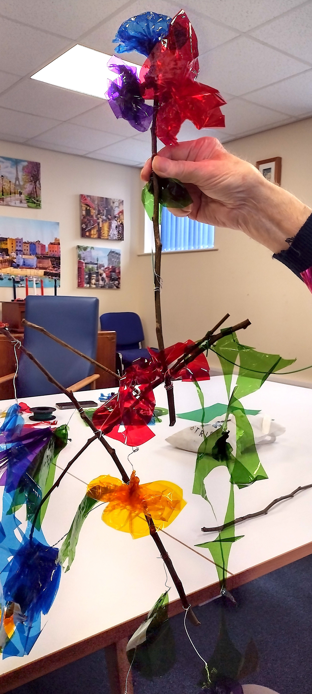
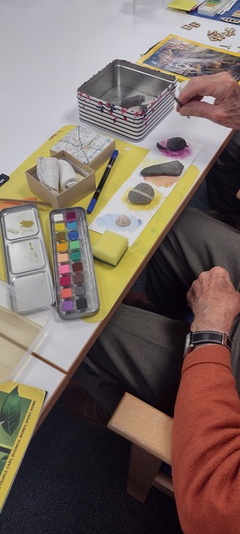
Hafan Ni - Our Home
Carers Trust Mochdre
“ A care setting where a person
living with dementia can
spend the day “
April - October 2024

Slide 2
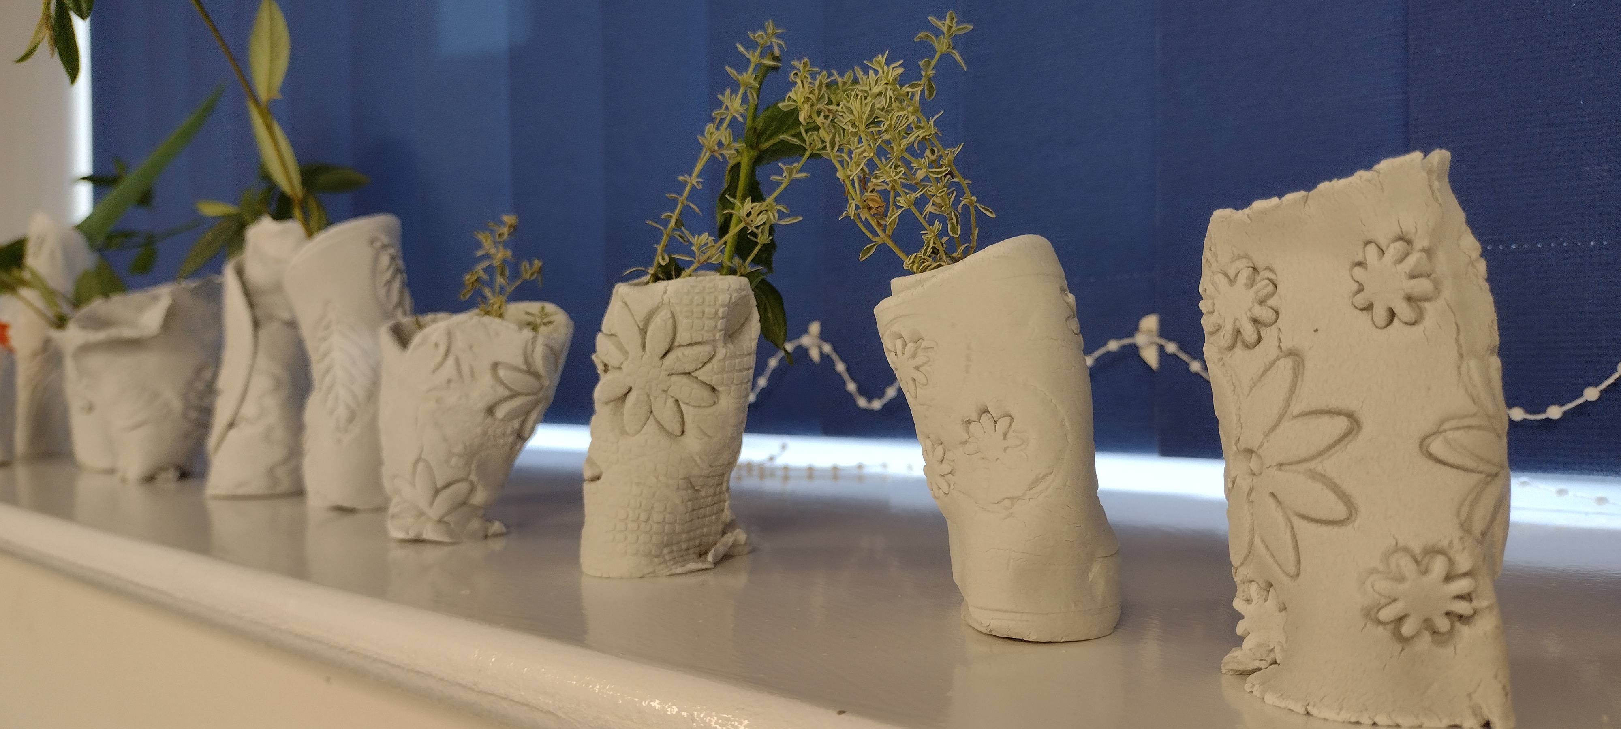
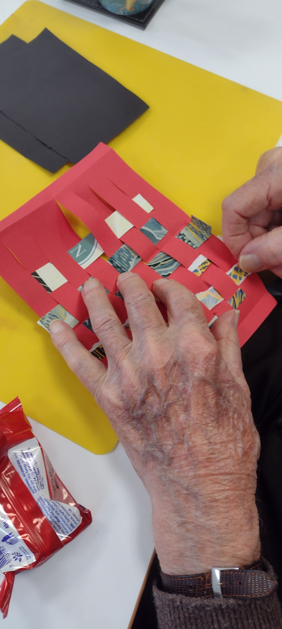
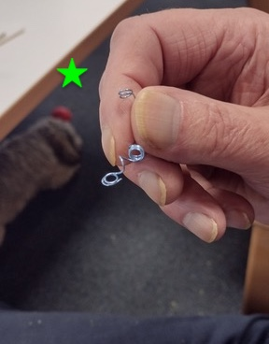
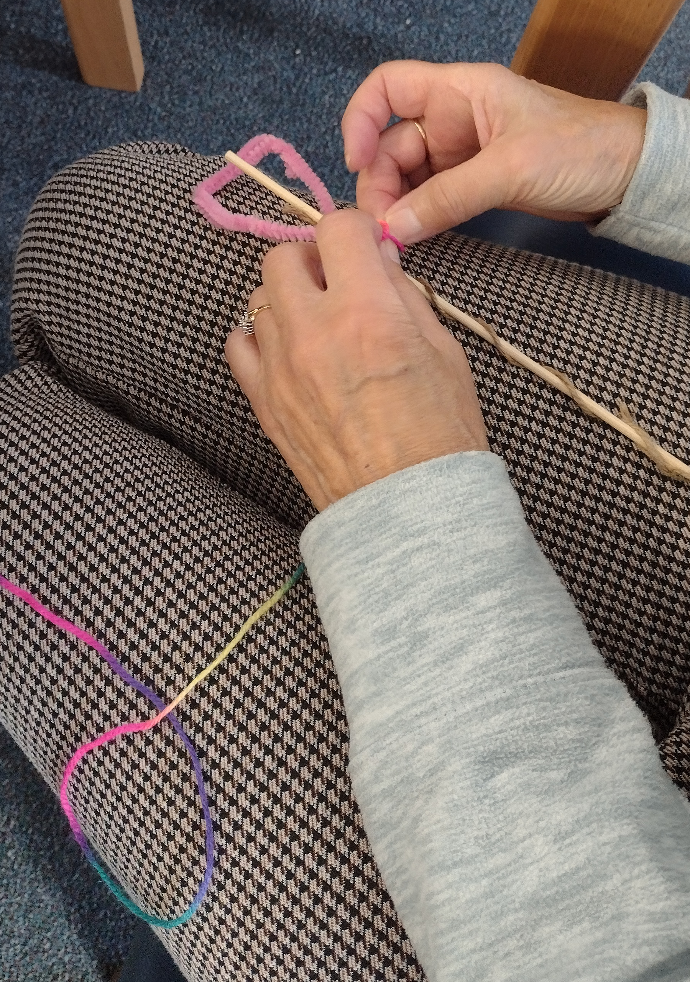
Exploring with people who are living in the community with Dementia, who meet up on Monday or a Tuesday at Hafan Ni. This gives their partner, family member, friend or carer an opportunity to catch up…
I visited each meeting in an afternoon once a month they are well
attended with 7 - 10 different people
on each day usually.
The people are cared for by Merv,
Angie, and Debbie.
Marion volunteers with the trust
and of course Bertie!!
I’d met some of the people earlier in the year exploring different materials with Care Creatively 2023. Toby the manager requested I continued to visit for familiarity - which was good news !

Slide 3
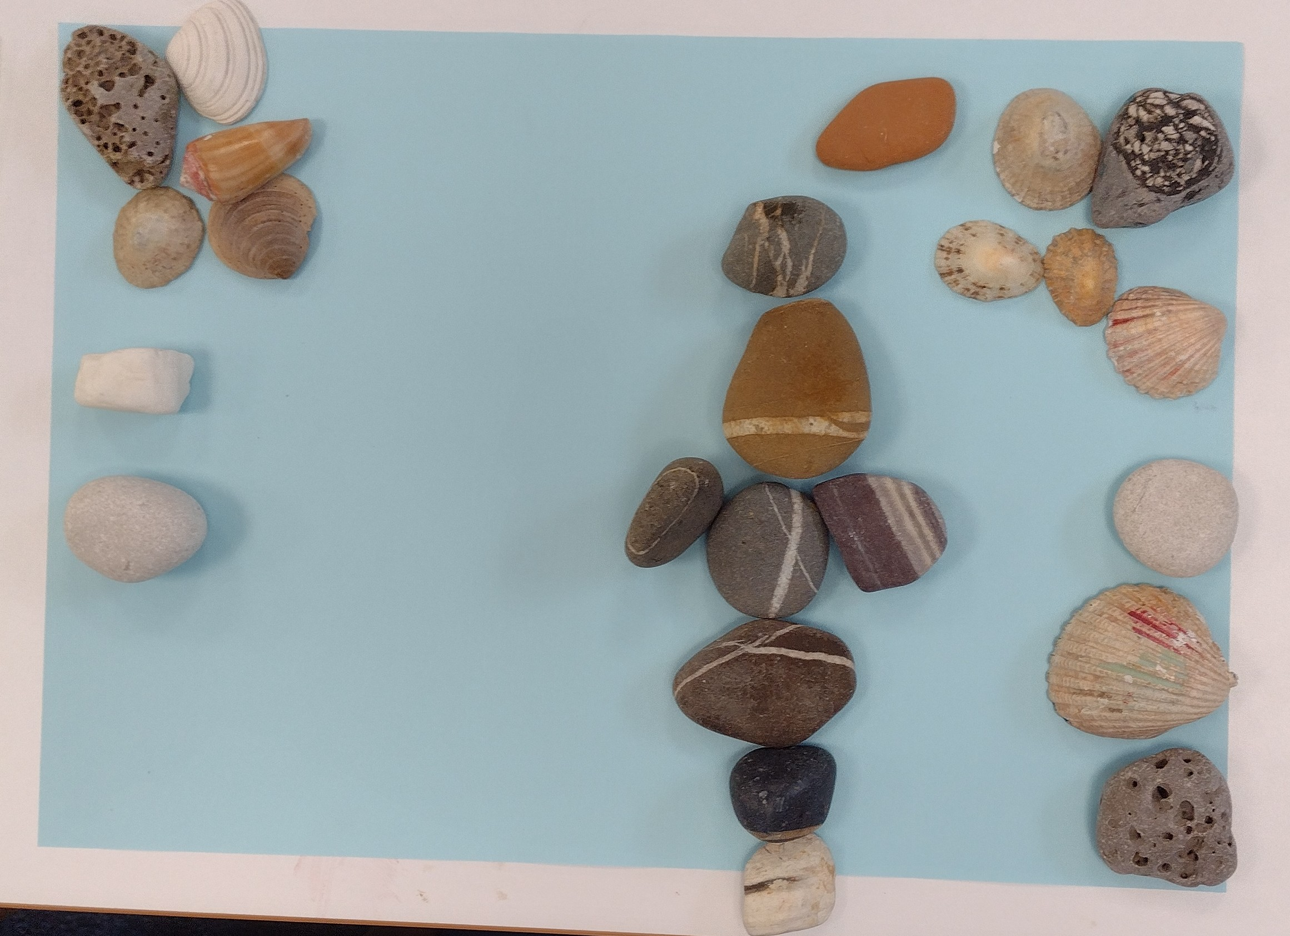
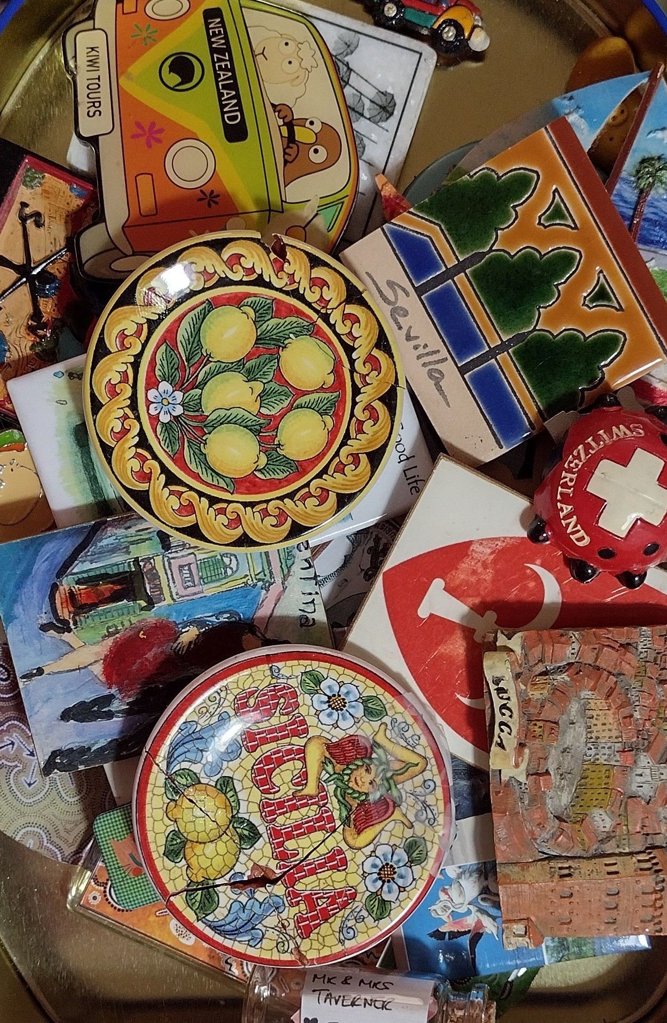
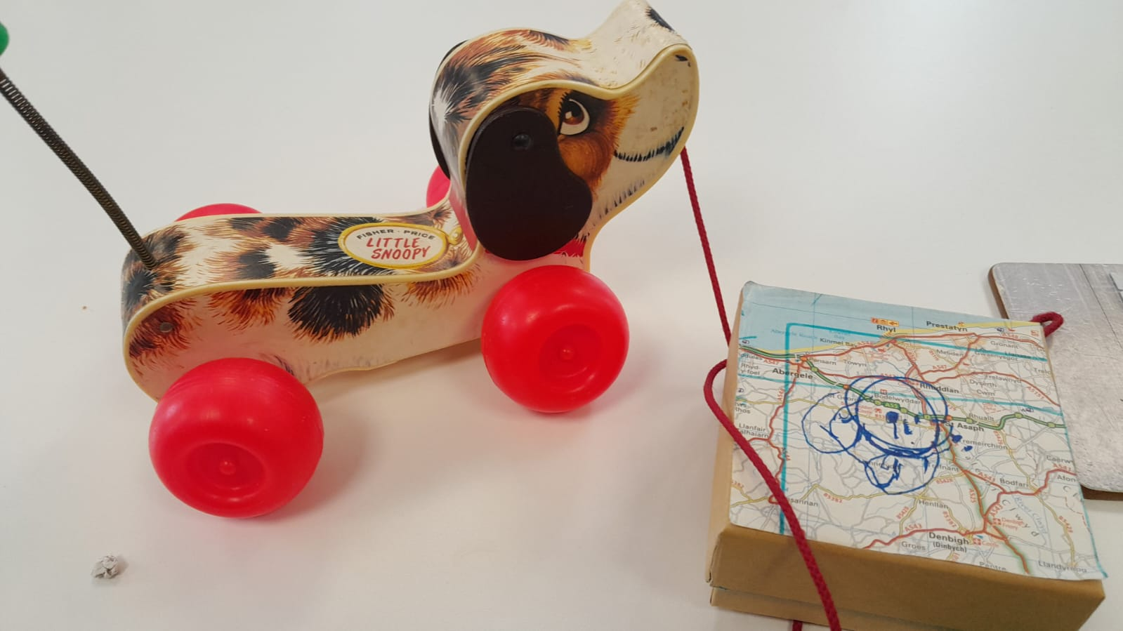
Katie Levy a historian joined us for three of the workshops sharing her knowledge of the objects in the Conwy boxes as well as her own collections, which included Dogs !
These sessions developed from one shared collection into our individual collections.

Slide 4
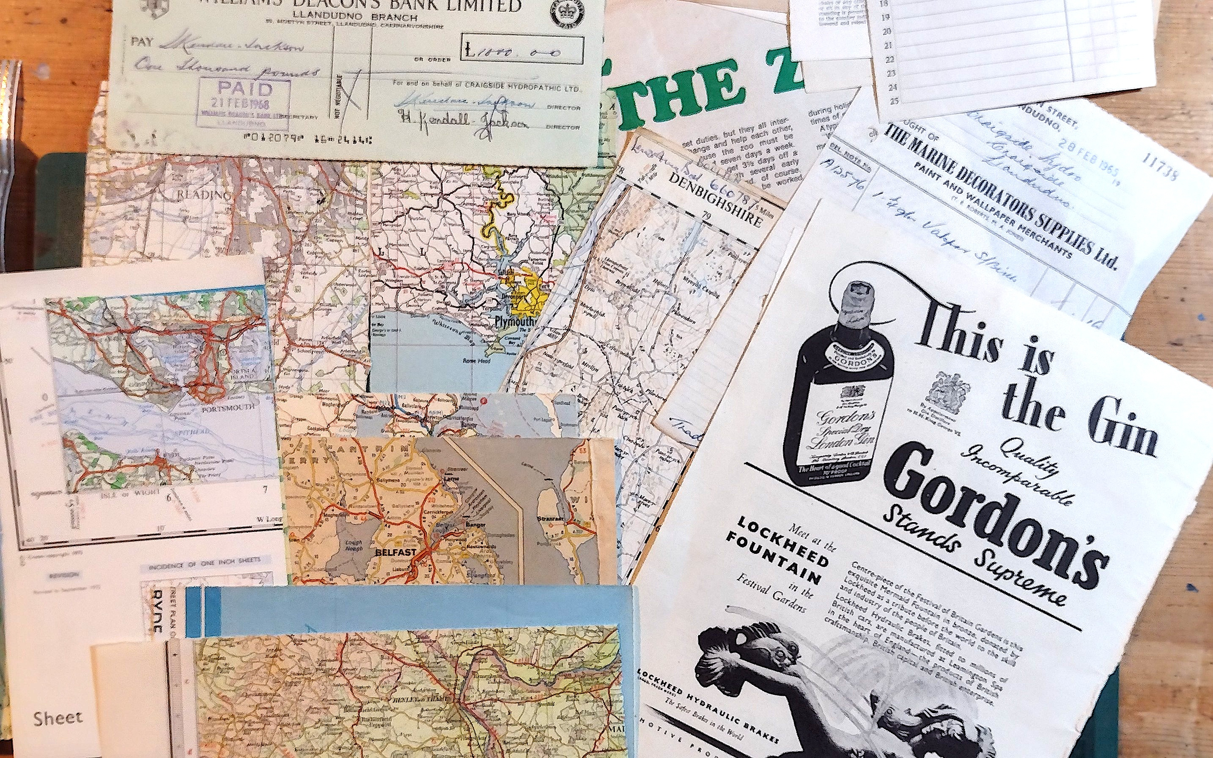
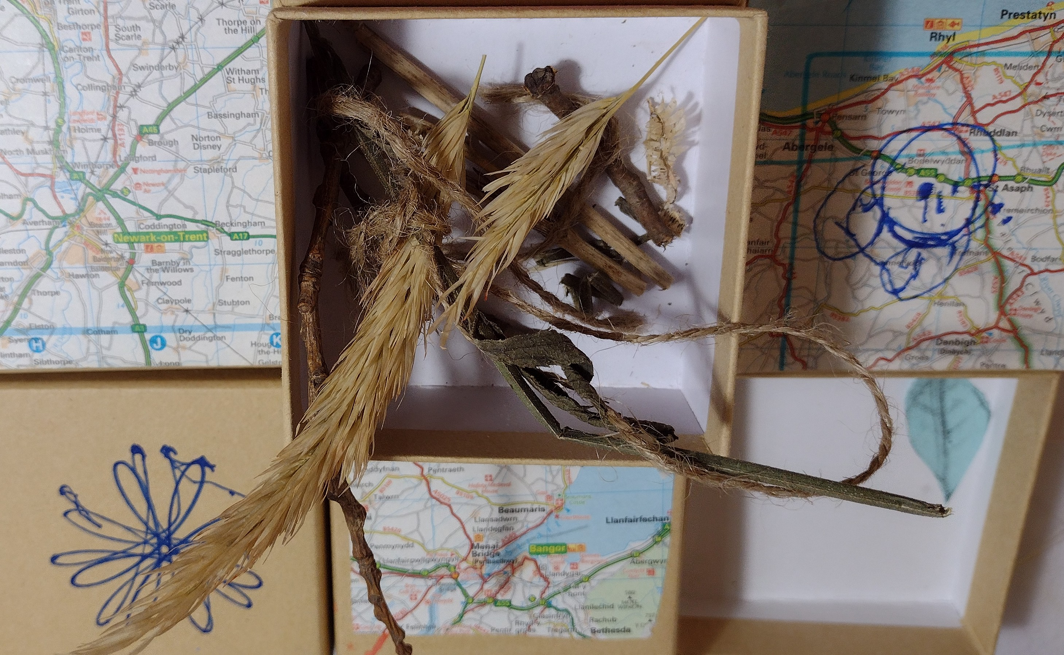
- We also shared the collage material that we were given at the start of the project. - ‘..some of the group placed objects out of boxes or bags …how people curated objects inspired us …we made our own story ‘ Hello Boxes’.
- 3 pieces of map stood out to me very special places in my life.. Leading to me not wanting to cut them up!?
- But this inspired, “ Where we were from, a holiday, or happy place - memories of good times.
- T was over the moon with ‘Killarney ‘ he used to travel around Ireland in a camper van and T kept doing the accent saying “that kiss”

Slide 5
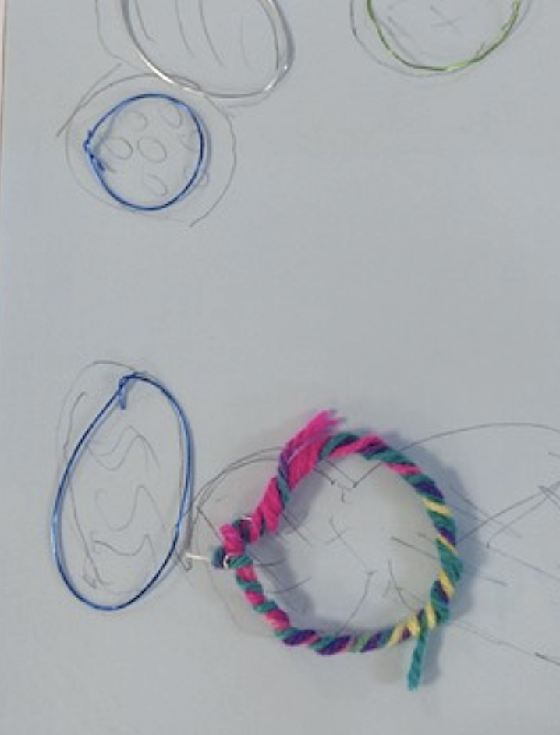
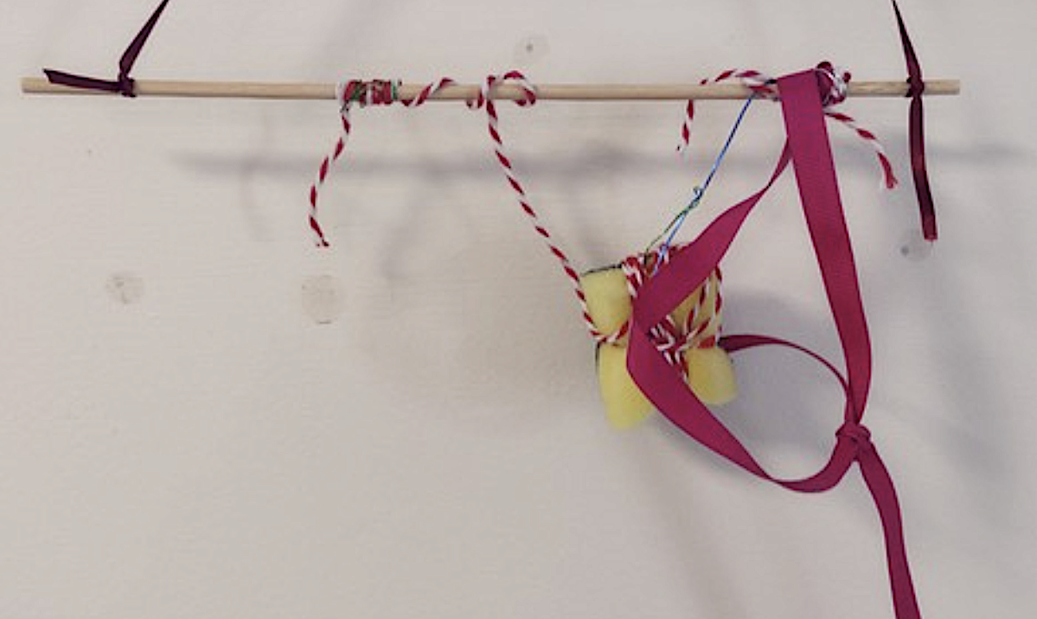
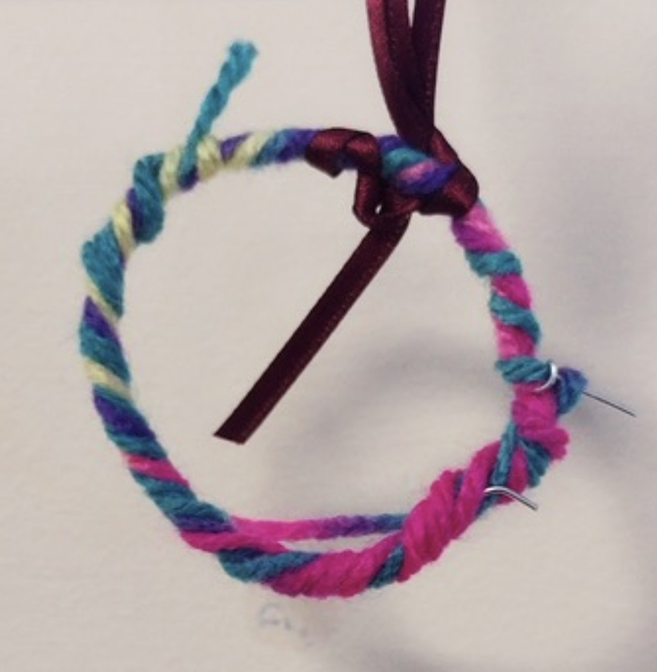
‘….it is the worst thing I could ask them to do “crafts “ as they put it ? ….brilliantly both compared and chatted about what they were doing, M saying“oh your showing off now “ L began using the sponge like a small parcel, M following her, they seemed happy, M said she’d enjoyed the afternoon! L directing me in detail as to how it should be hung horizontal rather than vertical...
’ It was really great to see G and L
both had inspired todays project.
a variation on story sticks -
combining different materials,
textures and shapes..’

Slide 6
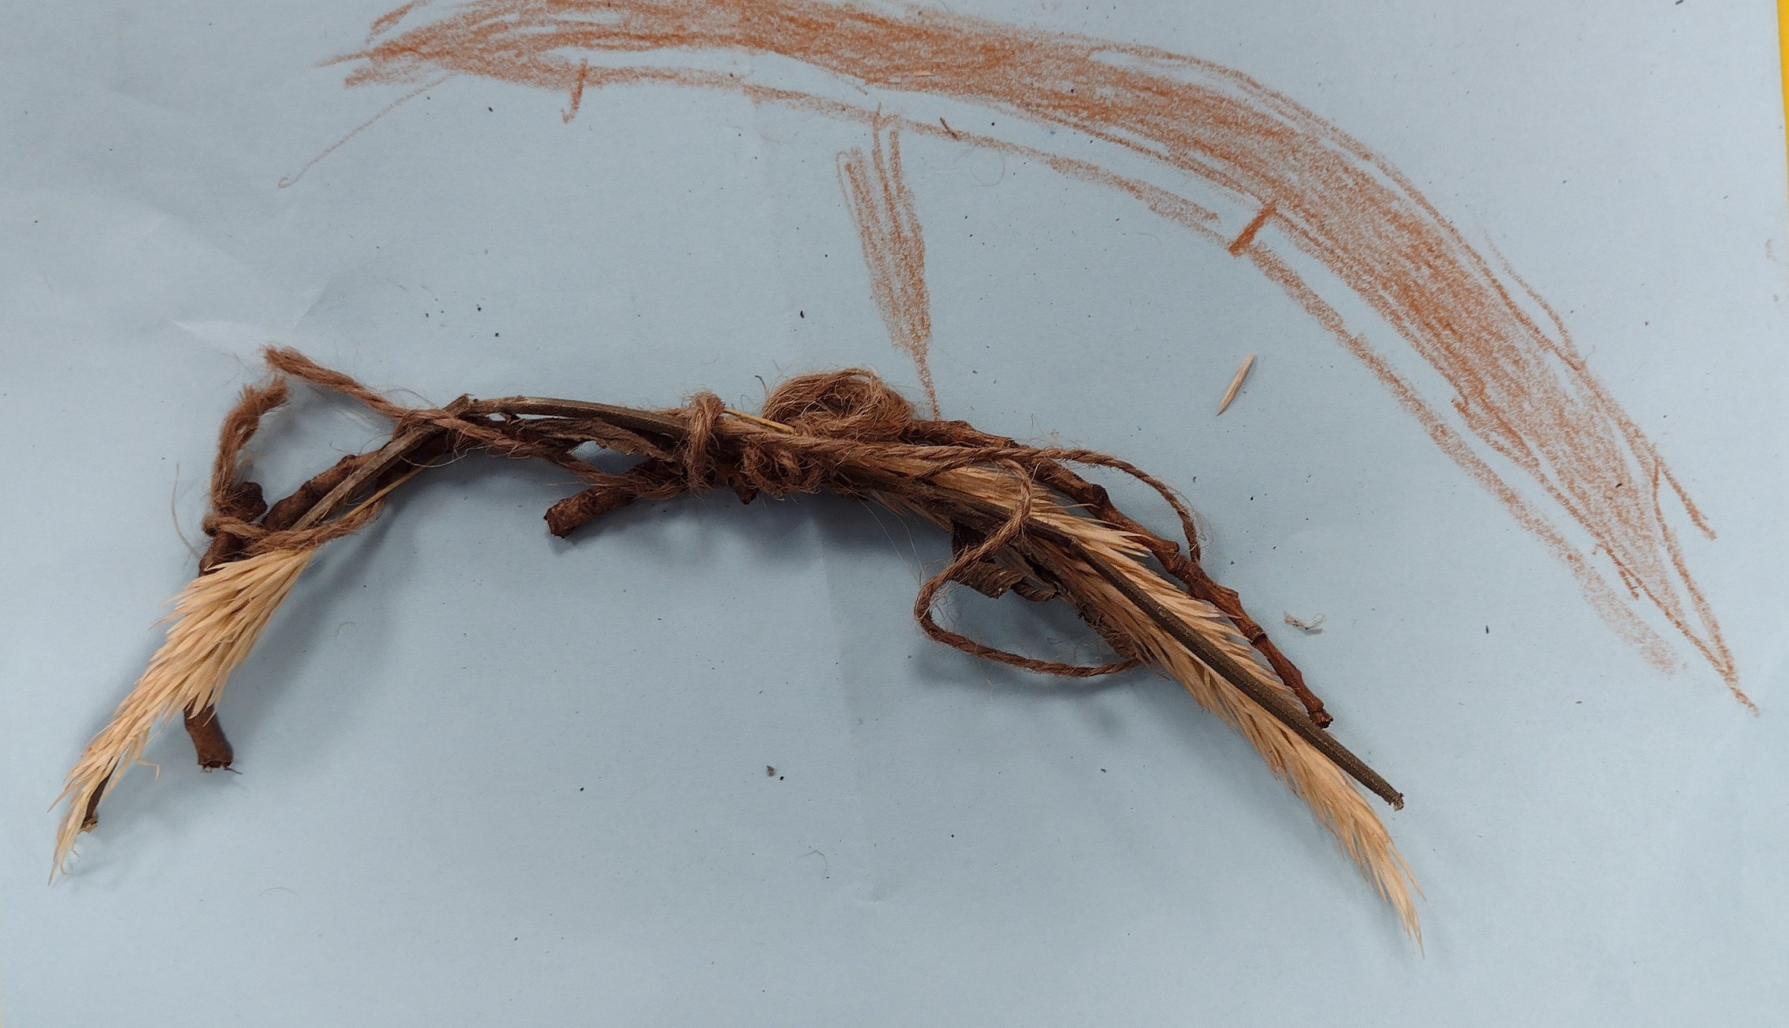
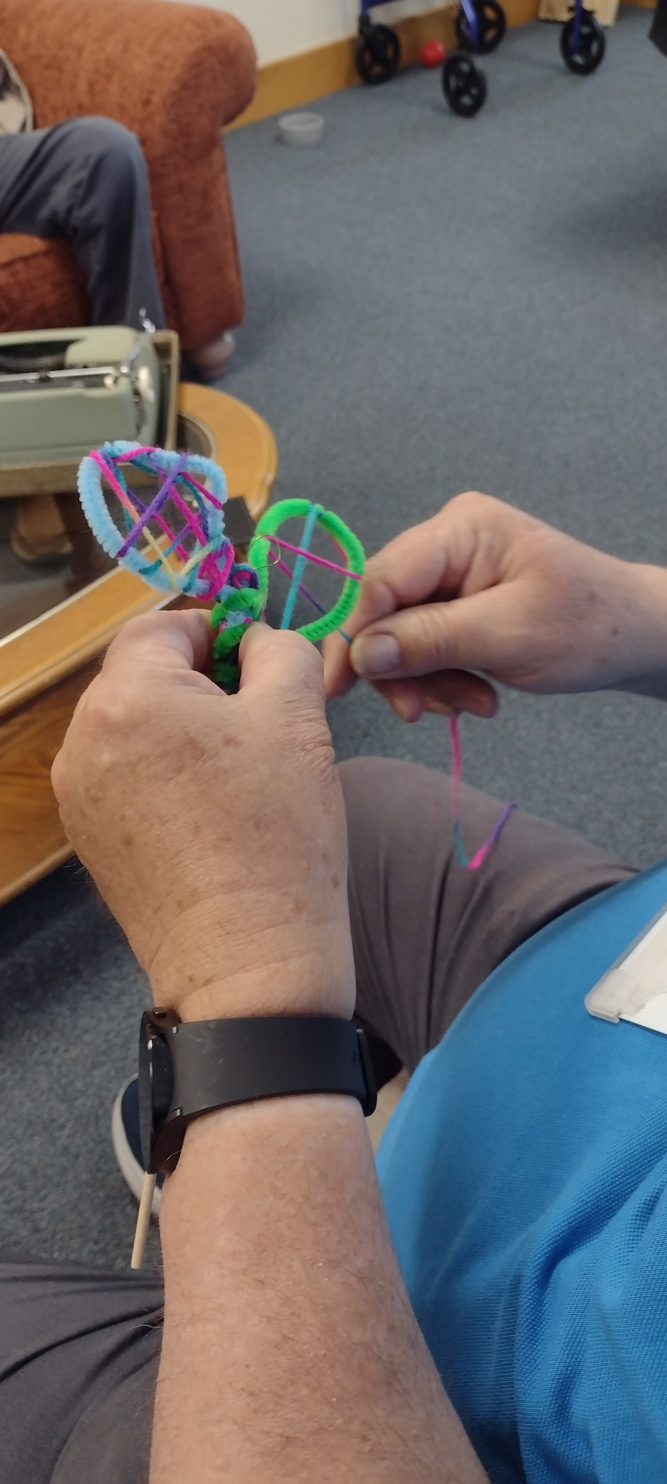
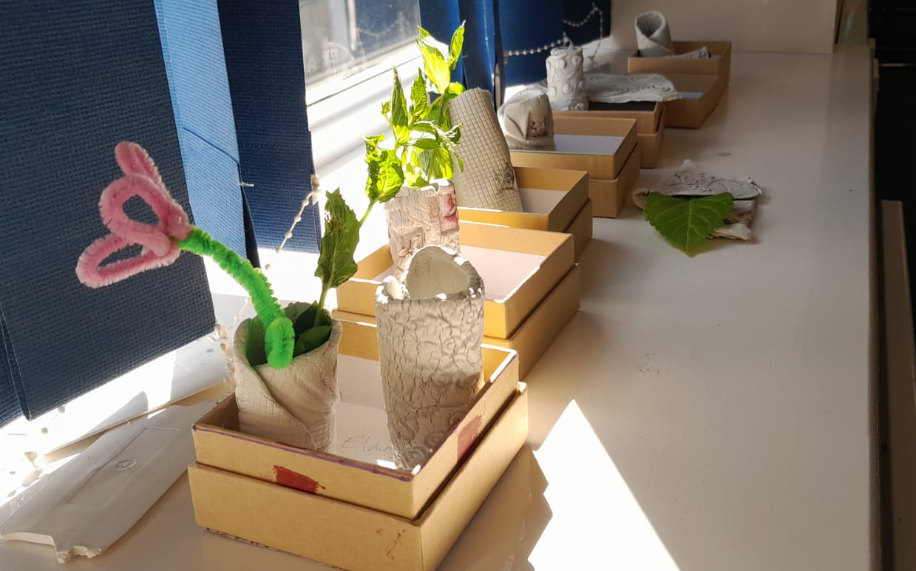
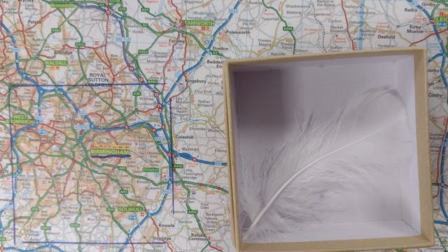
‘……to be enjoying themselves and getting involved,
working with wire and wool especially’

Slide 7
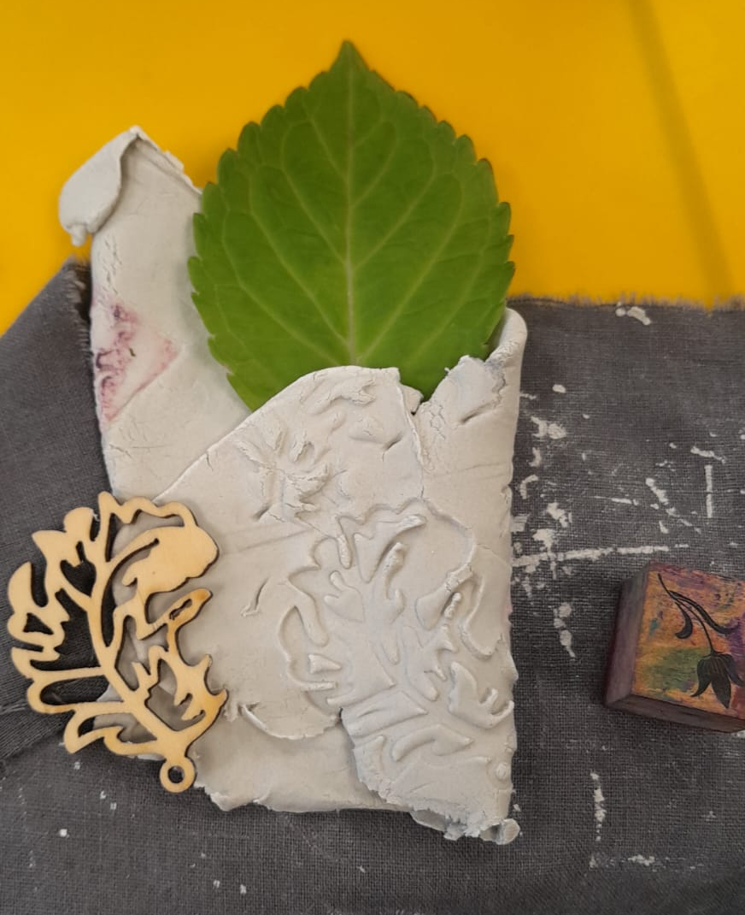
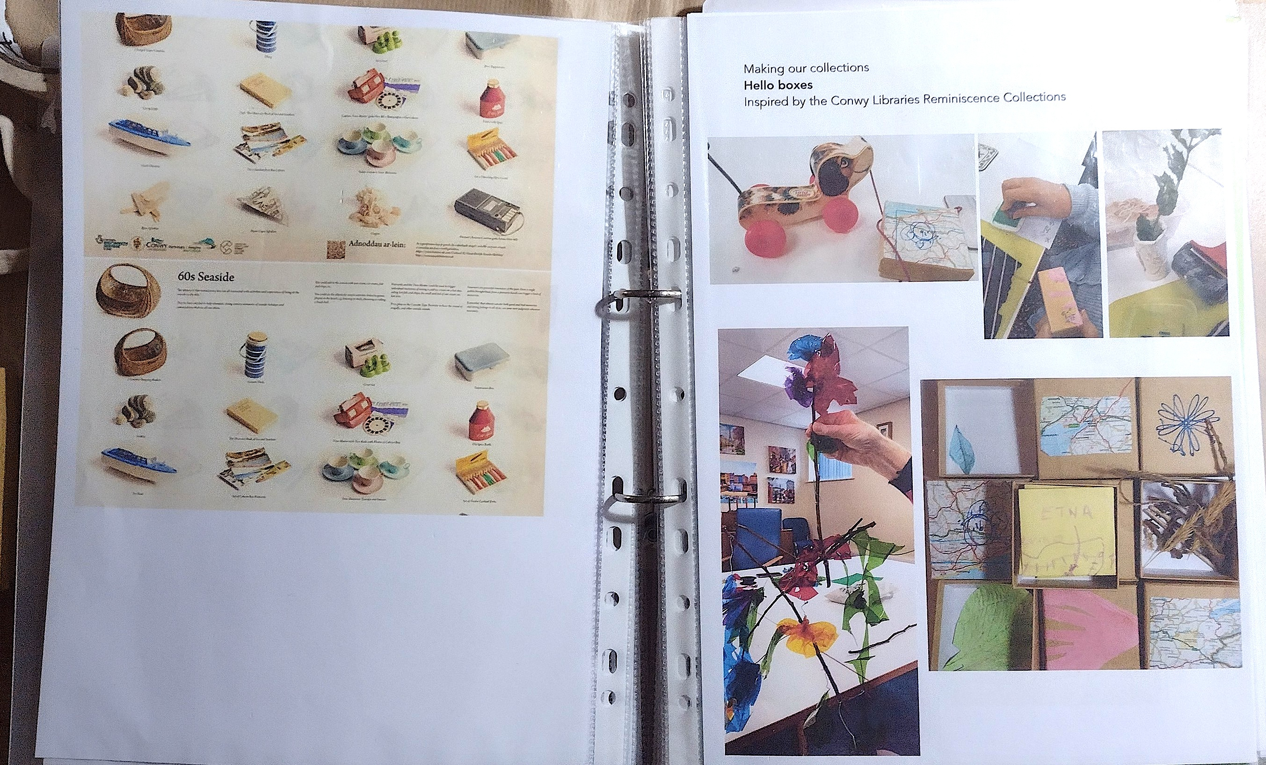
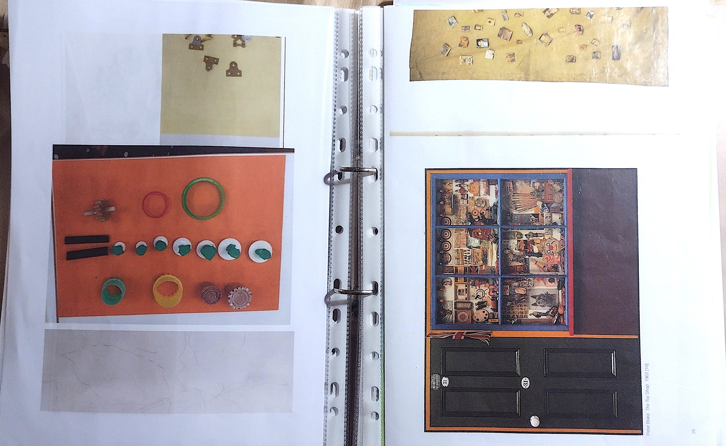
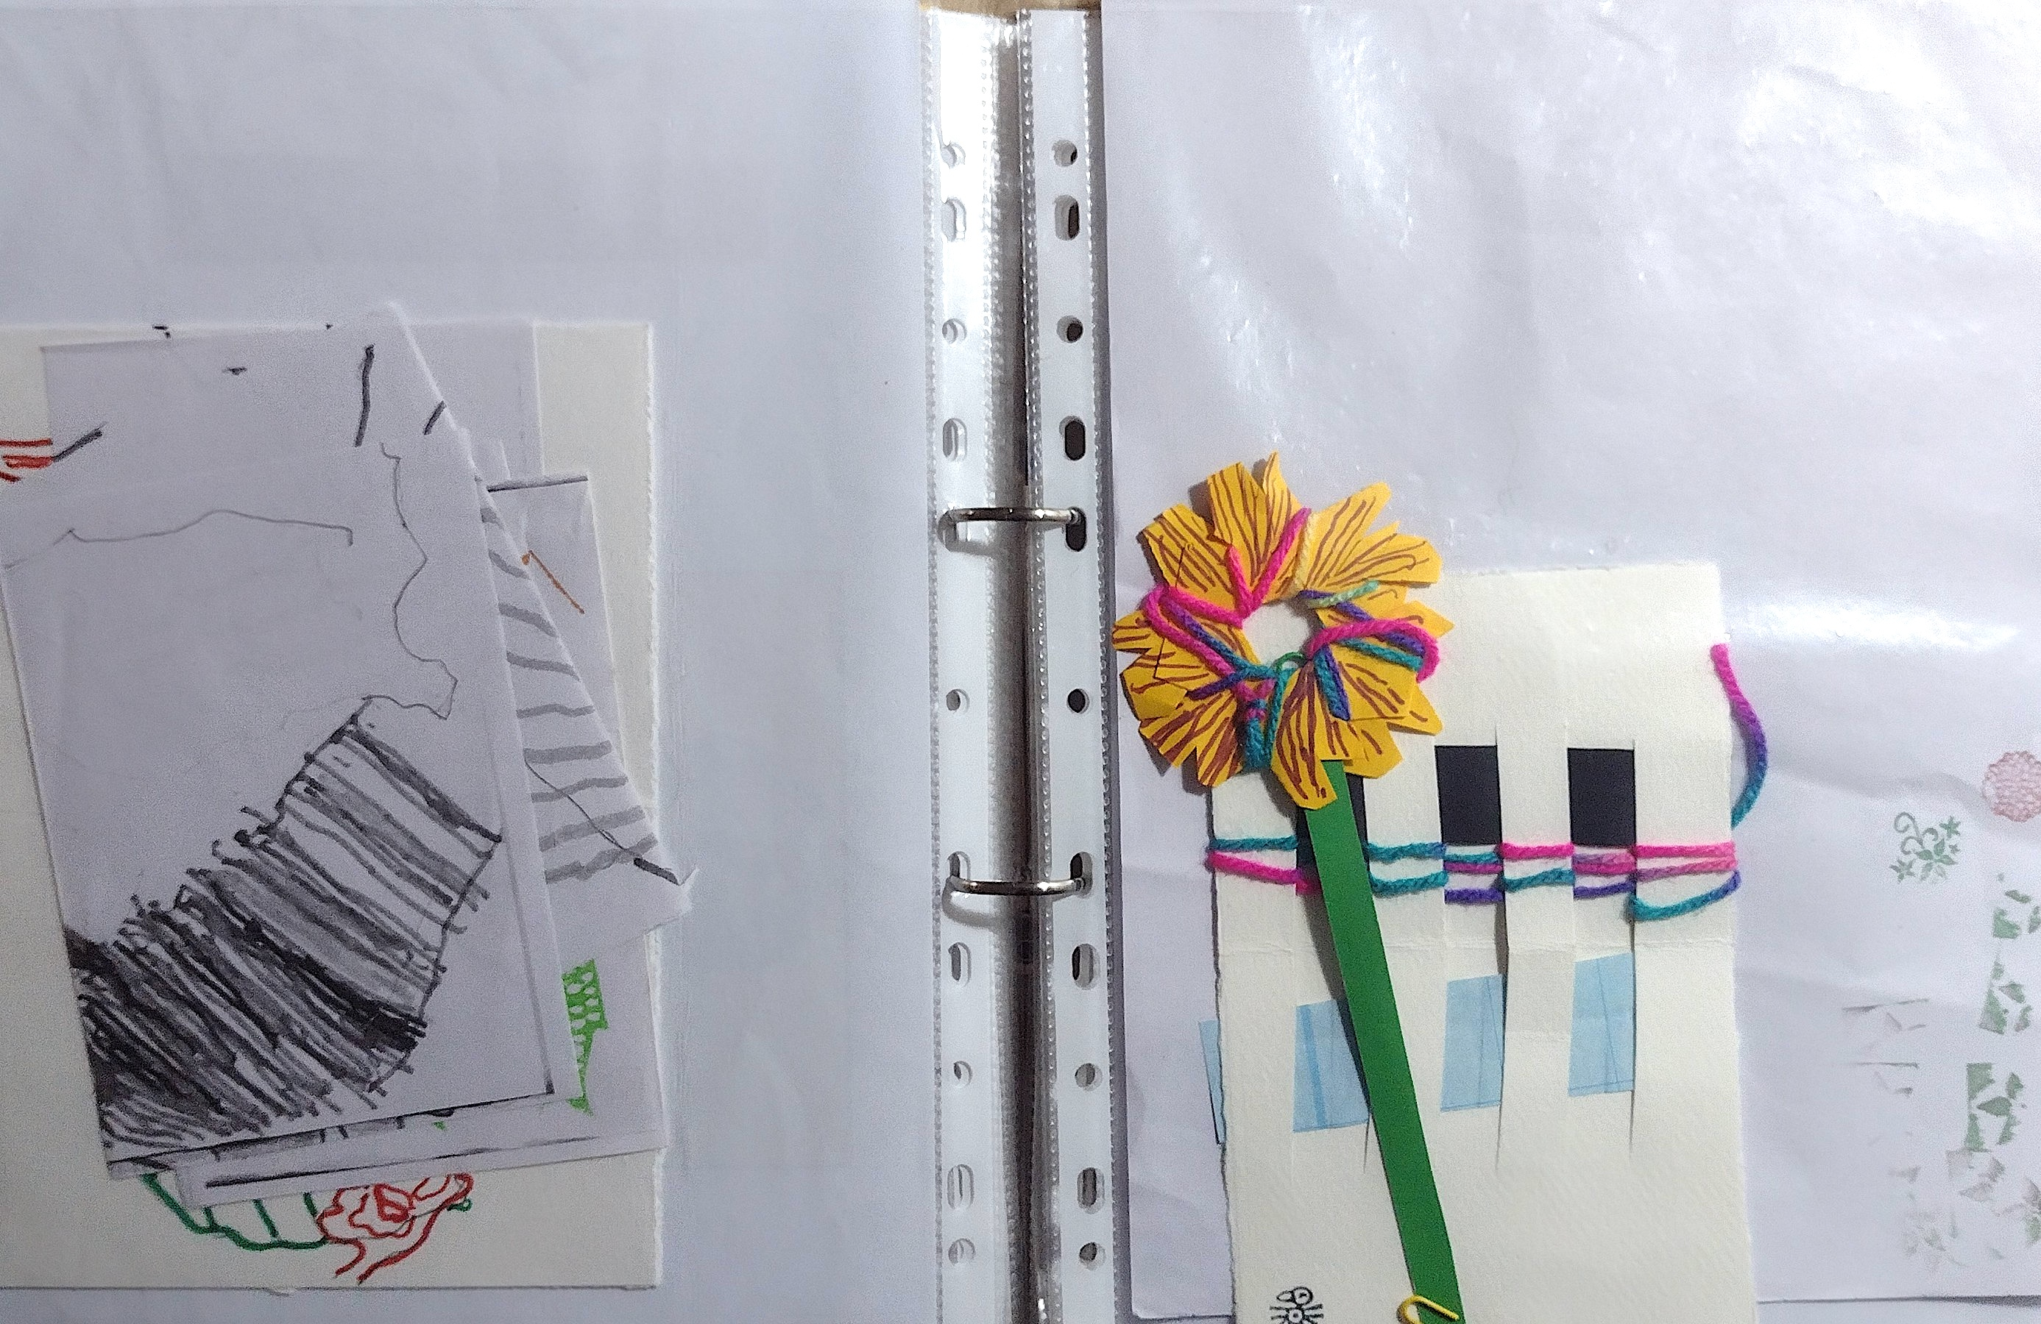
“….This helped developed our collection of ‘pieces ‘
we arranged photographed and rearranged.”
‘ A collection tray ‘ ..’
Diolch yn fawr, thank you !
Everyone I met and worked with at Hafar Ni for all their support
and Making Sense CIO with their funders for this opportunity
Tara

